Slide 1
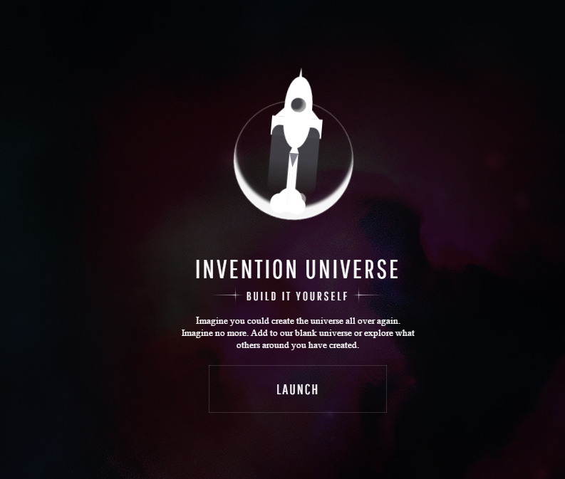

Slide 2
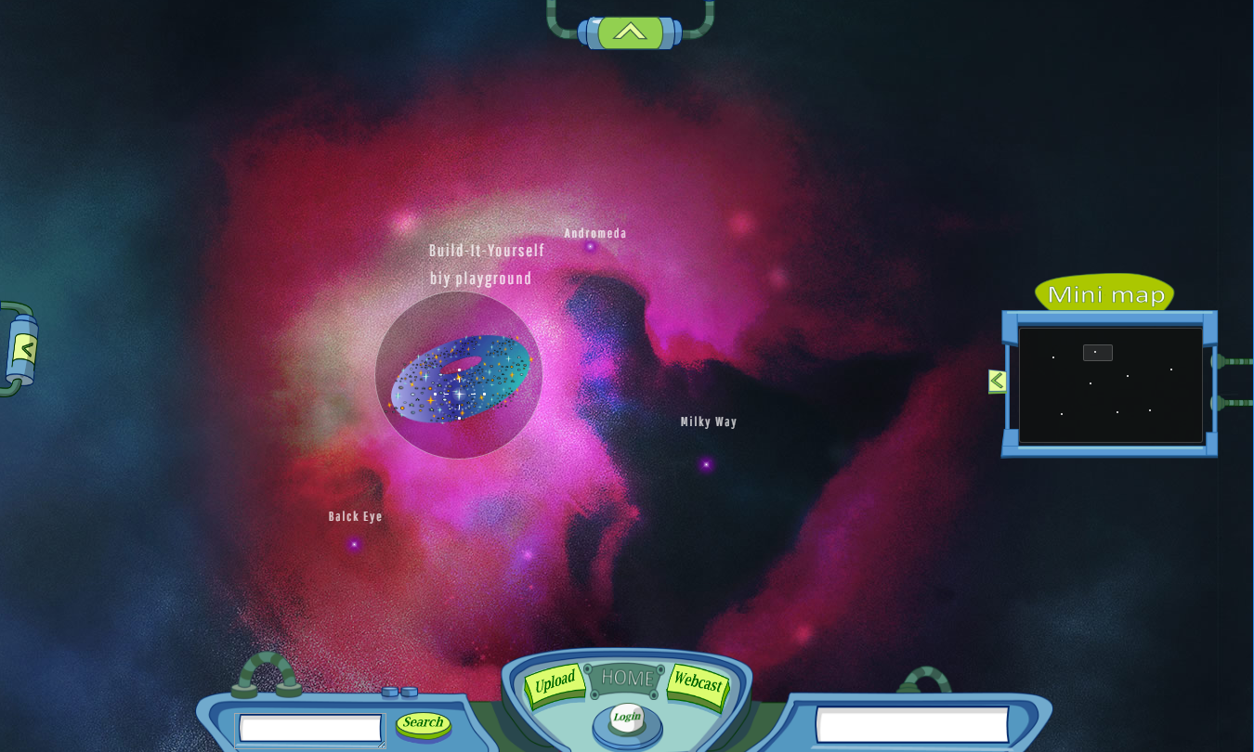

Slide 3
INVENTION UNIVERSE
We’re looking for a few intelligent life forms, smart ladies and hairy chested men to help us evolve a far out universe where art, nature and technology live in harmony. Many planets are barren and waiting for eager builders to bring them to life.
If you have the right stuff, we want you!”
Launch
How To Win Points | Design Goals | Wish List | Development Team | Trailers
Build-It-Yourself

Slide 5
Invention Universe
We’re looking for a few intelligent life forms, smart ladies and hairy chested men to help us evolve a utopian universe where art, nature and technology live in harmony. Many planets are barren and waiting for eager builders to bring them to life.
If you have the right stuff, we want you!”
Launch
How to win points
Trailers
Design goals
Wish list
Development Team

Slide 7
Galaxy

Slide 8

Galaxy

Slide 9
Galaxy

Slide 10
Galaxy

Slide 11
Star

Slide 12
Star
Build-It-Yourself

Slide 13
Planet

Slide 15
Planet
Worm holes or planets

Slide 16
Planet

Slide 17
Planet

Slide 18
Rocket
c
c
c

Slide 19
Rocket

Slide 20
Rocket

Slide 21
Alien

Slide 22
Alien

Slide 23


Alien

Slide 24


Star
Galaxy Goldfish

Slide 25

Galaxy Iron
Star Iron

Slide 26

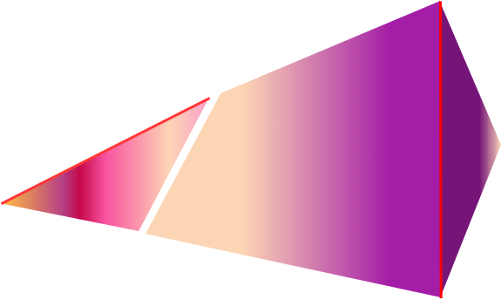
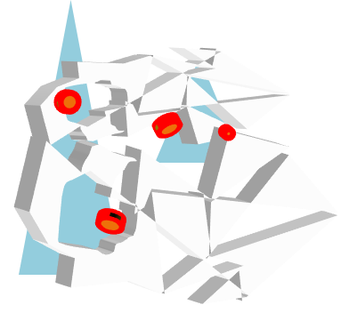
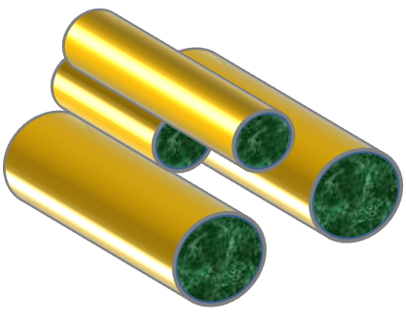

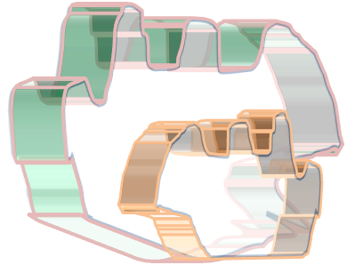
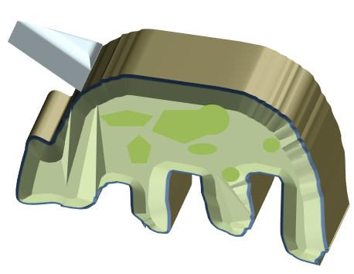
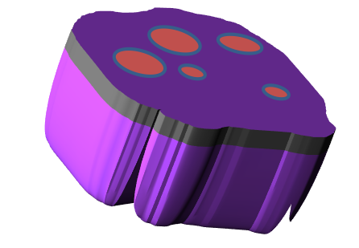
Planets

